Slide 1

Professional Development Associates
Controls as a Motivator
Michael L. Piazza

Slide 2

Michael L. Piazza
Principal Associate
Professional Development Associates
www.pda-usa.com
www.controlsframework.com

Slide 3
Presentation Agenda
Introduction
Organizational Process
Definition of Internal Control from ICIF 1992 to ICIF 2013
Definitions of Motivation
Maslow’s Hierarchy of Needs and Controls
Hertzberg’s Hygiene and Motivator Factors and Controls
Q&A

Slide 4
New Solutions
"Rarely do we find men and women who willingly engage in hard, solid thinking. There is an almost universal quest for easy answers and half-baked solutions. Nothing pains some people more than having to think."
Rev. Martin Luther King, Jr.

Slide 5
Organizational Process
Mission
Planning
Vision
Organizing
Values
Goals
Directing
RISKS
Objectives
Controlling

Slide 6
Objectives – Risks – Controls Relationship
Risks
Objectives
Controls

Slide 7
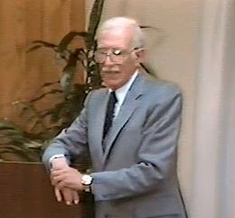
Auditor Motivation
Lawrence B. Sawyer
Practice of Modern Internal Auditing
“The Father of Modern Internal Auditing”
www.thesawyerlegacy.com
“Catch the manager doing something right!”
“The auditor’s job is to make the manager look good!”

Slide 8
Objectives – Risks – Controls Relationship
Risks
Objectives
Controls

Slide 9
COSO (Committee of Sponsoring Organizations)
Internal Control Integrated Framework
Publication and Tools - 1992
Update – March , 2013

Slide 10
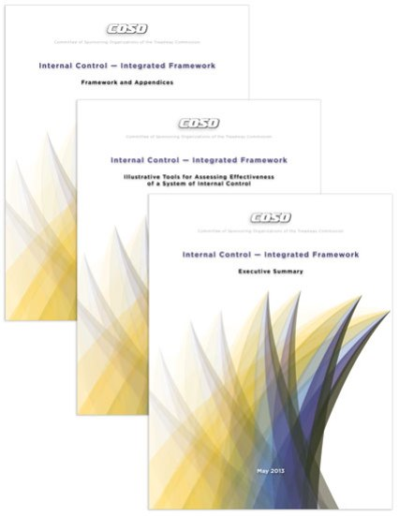
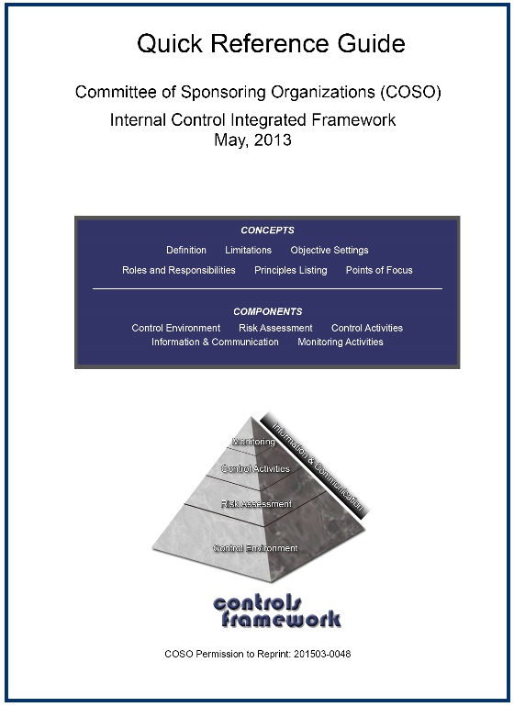
Institute of Internal Auditors - $174
Amazon.com - COSO Quick Reference Guide
$27 paperback
$9.99 Kindle edition

Slide 11
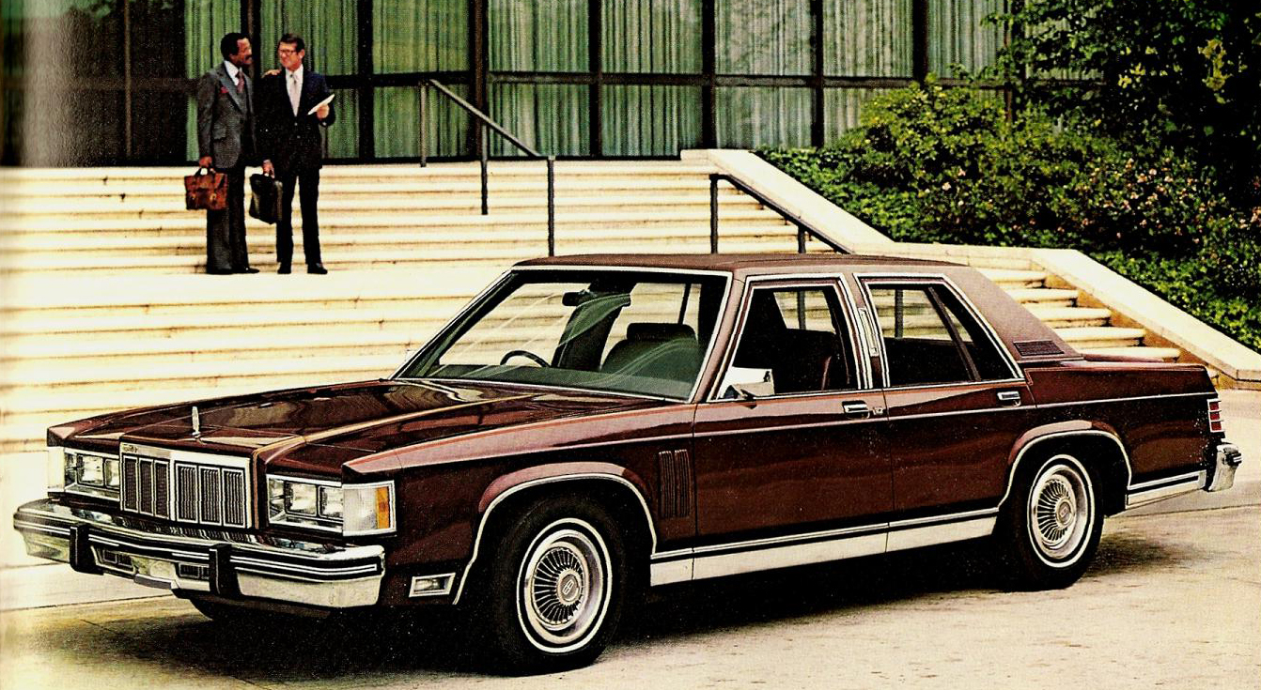
1984 Mercury Grand Marquis LS

Slide 12
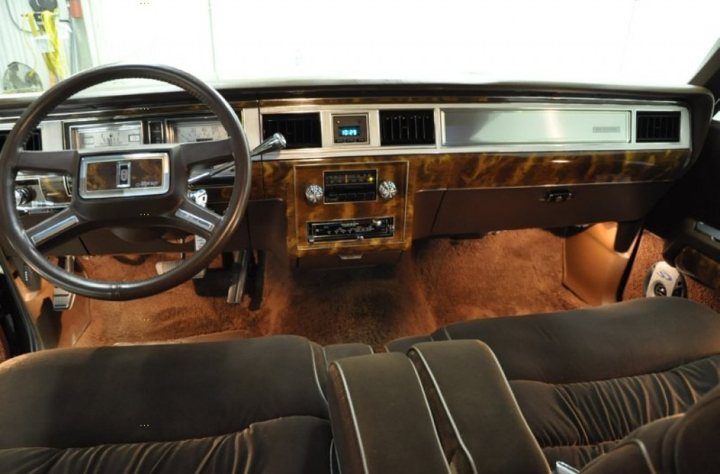
1984 Mercury Grand Marquis LS

Slide 13
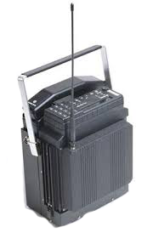
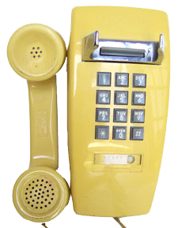
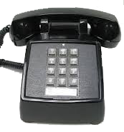
Phones from 1984
Wall phone
Desk phone
Cell phone

Slide 14
Committee of Sponsoring Organizations of
the Treadway Commission (COSO)
American Institute of Certified Public Accountants
American Accounting Association
The Institute of Internal Auditors
Institute of Management Accountants
Financial Executives Institute

Slide 15
Treadway Commission met with President Ronald Reagan
“Yes, as auditors we trust that management has sufficient controls
in place, but we must verify that.”
“ We trust but verify.”

Slide 17
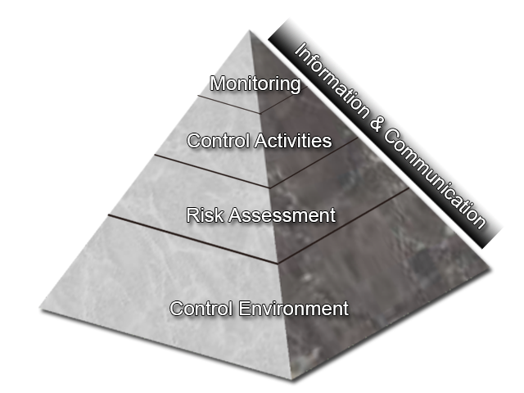

Slide 18
COSO Definition of Internal Control
ICIF 1992
Internal control is broadly defined as a process,
effected by an entity’s board of directors, management and other personnel,
designed to provide reasonable assurance regarding the achievement of objectives in the following categories:
  Effectiveness and efficiency of operations
  Reliability of financial reporting
  Compliance with applicable laws and regulations

Slide 19
Definition of Internal Control
From ICIF 1992 to 2013
Internal control is broadly defined as a process, effected by an entity’s board
of directors, management and other personnel, designed to provide
reasonable assurance regarding the achievement of objectives in the
following categories:
Effectiveness and efficiency of operations
Reliability of financial reporting
Compliance with applicable laws and regulations

Slide 20
Definition of Internal Control
From ICIF 1992 to 2013
Internal control is broadly defined as a process, effected by an entity’s board
of directors, management and other personnel, designed to provide
reasonable assurance regarding the achievement of objectives in the
following categories: relating to:
Effectiveness and efficiency of operations
Reliability of financial reporting
Compliance with applicable laws and regulations

Slide 21
Definition of Internal Control
ICIF 2013
Internal control is a process, effected by an entity’s board of directors, management, and other personnel, designed to provide reasonable assurance regarding the achievement of objectives relating to operations, reporting, and compliance.

Slide 22
Definition
“Work motivation is a set of energetic forces that originate both within as well as beyond an individual’s being, to initiate work-related behavior, and to determine its form, direction, intensity, and duration.”
Pinder (1998)

Slide 23
Motivation Defined
Other authors have also defined the concept of motivation. Motivation has been defined as:
the psychological process that gives behavior purpose and direction
a predisposition to behave in a purposive manner to achieve specific, unmet needs
an internal drive to satisfy an unsatisfied need; and the will to achieve
operationally defined as the inner force that drives individuals to accomplish personal and organizational goals.

Slide 24
Maslow’s Hierarchy of Needs
Food, clothing, shelter, other necessities of life
    At one point actual living quarters, etc. exchanged for work
    Wages and earnings provide these needs today
    Considered second nature in wealthier societies
    Provided by a variety of sources in American society
Basic Needs

Slide 25
Maslow’s Hierarchy of Needs
A sense of security in the future, immediate and distant
    Developed as a motivation tool with Social Security
    Further refined as pensions, retirement plans
    Becoming a renewed compensation factor in America
    Prime motivator in developing nations/economies
Safety and Security
Basic Needs

Slide 26
Maslow’s Hierarchy of Needs
A sense of group identity and sense of purpose
      Began to be used as a motivator post WWII
      Strong motivator in the 1960’s thru 1990’s
      Basis for societal placement and awareness
      Both organizational and professional belonging
Belongingness
Safety and Security
Basic Needs

Slide 27
Maslow’s Hierarchy of Needs
A sense of accomplishment, achievement orientation
      Strong professional/management motivator
      Self perception and ego fulfillment
Ego - Self Esteem
Belongingness
Safety and Security
Basic Needs

Slide 28
Maslow’s Hierarchy of Needs
Need to create
Be in the now
No fear of the future
No regret of the past
Self, in the moment
Self Actualization
Ego - Self Esteem
Belongingness
Safety and Security
Basic Needs

Slide 29
Maslow’s Hierarchy of Needs
“Don’t worry about self-actualization,
you will never achieve it.”
Self Actualization
NEEDS HIERARCHY
NOT ACHIEVEMENTS
Ego - Self Esteem
Belongingness
Safety and Security
Basic Needs

Slide 30
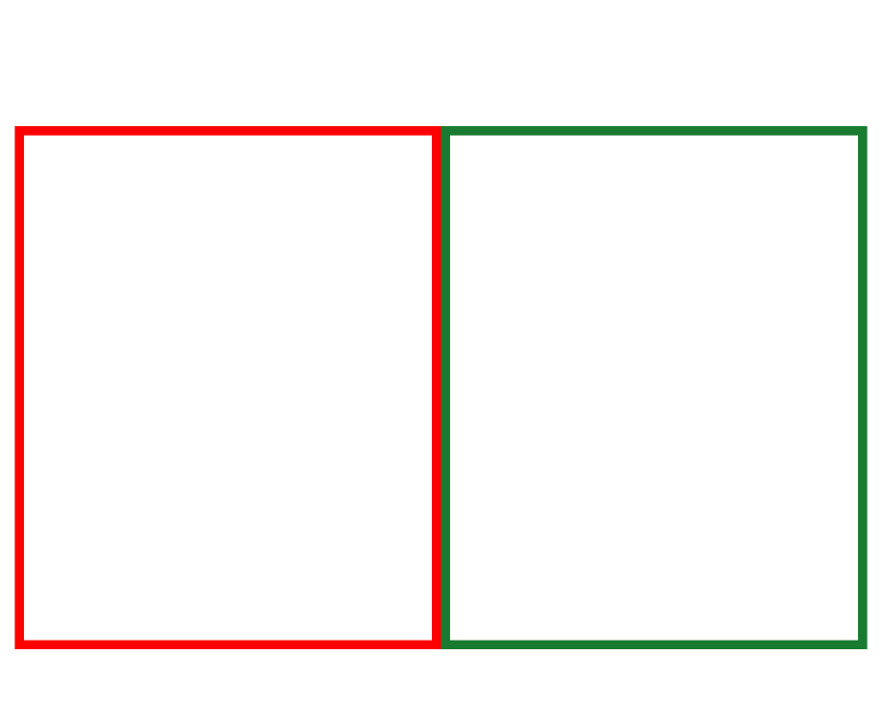
Hertzberg's Motivational Model
Hygiene Factors
Motivator Factors
Dissatisfiers
Satisfiers
Presence creates satisfaction
Absence does not create dissatisfaction
Presence does not create satisfaction
Absence creates dissatisfaction
-10 -9 -8 -7 -6 -5 -4 -3 -2 -1 0 1 2 3 4 5 6 7 8 9 10

Slide 31
Hertzberg's Motivational Model
Hygiene Factors
Motivator Factors
Dissatisfaction
Satisfaction
Achievement
Recognition
Work Itself
Policy and Procudures/Admininstration
Supervision
-10 -9 -8 -7 -6 -5 -4 -3 -2 -1 0 1 2 3 4 5 6 7 8 9 10

Slide 32
Demonstrates Commitment to Competence
Principle 4: The organization demonstrates a commitment to attract, develop, and retain competent individuals in alignment with objectives.
Points of Focus
Establishes Policies and Practices—Policies and practices reflect expectations of competence necessary to support the achievement of objectives.
Evaluates Competence and Addresses Shortcomings—The board of directors and management evaluate competence across the organization and in outsourced service providers in relation to established policies and practices, and acts, as necessary to address shortcomings.
Attracts, Develops, and Retains Individuals—The organization provides the mentoring and training needed to attract, develop, and retain sufficient and competent personnel and outsourced service providers to support the achievement of objectives.
Plans and Prepares for Succession—Senior management and the board of directors develop contingency plans for assignments of responsibility important for internal control.

Slide 33
Perception of Control Environment
Rate on a scale of 1 through 10 (10 being the highest) how you perceive your organization’s efforts to develop individuals in accomplishing objectives and achieving success .
Rate on a scale of 1 through 10 (10 being the highest) how you believe most employees perceive your organization’s efforts to develop individuals in accomplishing objectives and achieving success .

Slide 34
Hertzberg's Motivational Model
Hygiene Factors
Motivator Factors
Dissatisfaction
Satisfaction
Achievement
0 1 2 3 4 5 6 7 8 9 10
-10 -9 -8 -7 -6 -5 -4 -3 -2 -1 0 1 2 3 4 5 6 7 8 9 10

Slide 35
Deploys through Policies and Procedures
Principle 12: The organization deploys control activities through policies that establish what is expected and procedures that put policies into action.
Points of Focus:
Establishes Policies and Procedures to Support Deployment of Management’s Directives—Management establishes control activities that are built into business processes and employees’ day-to-day activities through policies establishing what is expected and relevant procedures specifying actions.
Establishes Responsibility and Accountability for Executing Policies and Procedures—Management establishes responsibility and accountability for control activities with management (or other designated personnel) of the business unit or function in which the relevant risks reside.
Performs in a Timely Manner—Responsible personnel perform control activities in a timely manner as defined by the policies and procedures.
Takes Corrective Action—Responsible personnel investigate and act on matters identified as a result of executing control activities.
Performs Using Competent Personnel—Competent personnel with sufficient authority perform control activities with diligence and continuing focus.
Reassesses Policies and Procedures—Management periodically reviews control activities to determine their continued relevance, and refreshes them when necessary.

Slide 36
Perception of Control Activities
Rate on a scale of 1 through 10 (10 being the highest) how you perceive the policy and procedures of your organization.
Rate on a scale of 1 through 10 (10 being the highest) how you believe most employees perceive the policy and procedures of your organization.

Slide 37
Hertzberg's Motivational Model
Hygiene Factors
Motivator Factors
Dissatisfaction
Satisfaction
Policy and Procudures/Admininstration
0 1 2 3 4 5 6 7 8 9 10
-10 -9 -8 -7 -6 -5 -4 -3 -2 -1 0 1 2 3 4 5 6 7 8 9 10

Slide 38
Establishes Structure, Authority, and Responsibility
Principle 3: Management establishes, with board oversight, structures, reporting lines, and appropriate authorities and responsibilities in the pursuit of objectives.
Points of Focus:
Considers All Structures of the Entity—Management and the board of directors consider the multiple structures used (including operating units, legal entities, geographic distribution, and outsourced service providers) to support the achievement of objectives.
Establishes Reporting Lines—Management designs and evaluates lines of reporting for each entity structure to enable execution of authorities and responsibilities and flow of information to manage the activities of the entity.
Defines, Assigns, and Limits Authorities and Responsibilities—Management and the board of directors delegate authority, define responsibilities, and use appropriate processes and technology to assign responsibility and segregate duties as necessary at the various levels of the organization:
  Board of Directors—Retains authority over significant decisions and reviews management’s assignments and limitations of authorities and responsibilities.
  Senior Management—Establishes directives, guidance, and control to enable management and other personnel to understand and carry out their internal control responsibilities.
  Management—Guides and facilitates the execution of senior management directives at entity and its subunits.
  Personnel—Understands the entity’s standard of conduct, assessed risks to objectives, and the related control activities at their respective levels of the entity, the expected information and communication flow, and monitoring activities relevant to their achievement of the objectives.
  Outsourced Service Providers—Adheres to management’s definition of the scope of authority and responsibility for all non-employees engaged.

Slide 39
Perception of Supervision
Rate on a scale of 1 through 10 (10 being the highest) how you perceive the supervision of your organization.
Rate on a scale of 1 through 10 (10 being the highest) how you believe most employees perceive the supervision of your organization.

Slide 40
Hertzberg's Motivational Model
Hygiene Factors
Motivator Factors
Dissatisfaction
Satisfaction
Supervision
0 1 2 3 4 5 6 7 8 9 10
-10 -9 -8 -7 -6 -5 -4 -3 -2 -1 0 1 2 3 4 5 6 7 8 9 10

Slide 41
Hertzberg's Motivational Model
Hygiene Factors
Motivator Factors
Dissatisfaction
Satisfaction
Achievement
0 1 2 3 4 5 6 7 8 9 10
Policy and Procudures/Admininstration
0 1 2 3 4 5 6 7 8 9 10
Supervision
0 1 2 3 4 5 6 7 8 9 10
-10 -9 -8 -7 -6 -5 -4 -3 -2 -1 0 1 2 3 4 5 6 7 8 9 10

Slide 42
Copy of today’s slides:
www.pda-usa.com
“PDA Publications”
Slides from the IIA Chapter Meeting 12/01/15

